Slide 1
Procedural Texture
Perlin Noise

Slide 2
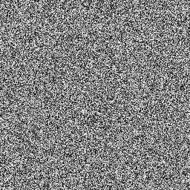
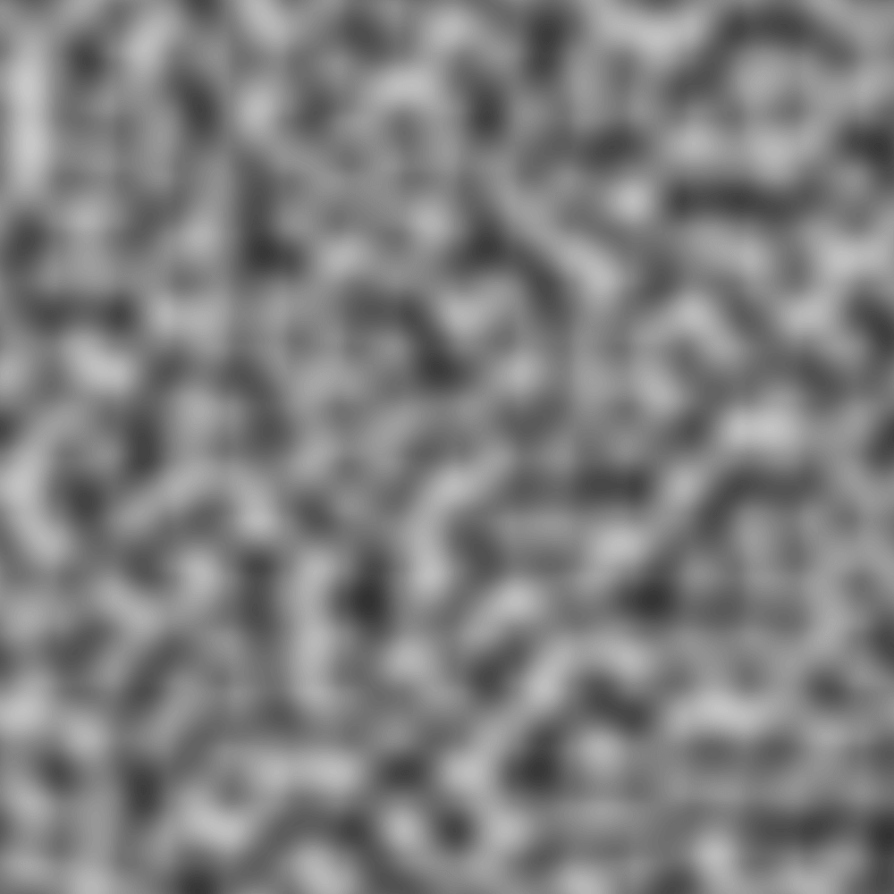
White Noise vs Perlin Noise
Natural Spatial Variance
Random Trend
White Noise
Perlin Noise

Slide 3
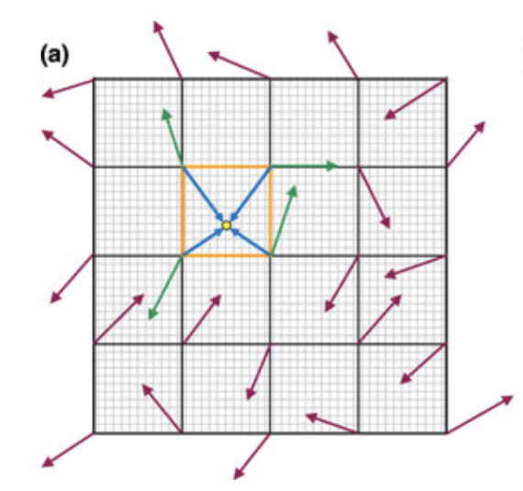
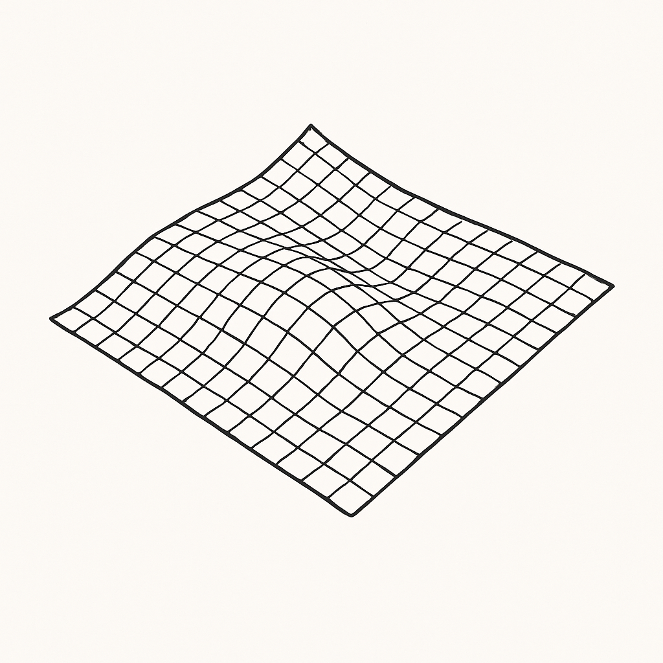
Basic Idea
Locality
Continuity
Consistency
(a)THUBreast: an open-source breast phantom generation software for x-ray imaging and dosimetry

Slide 4
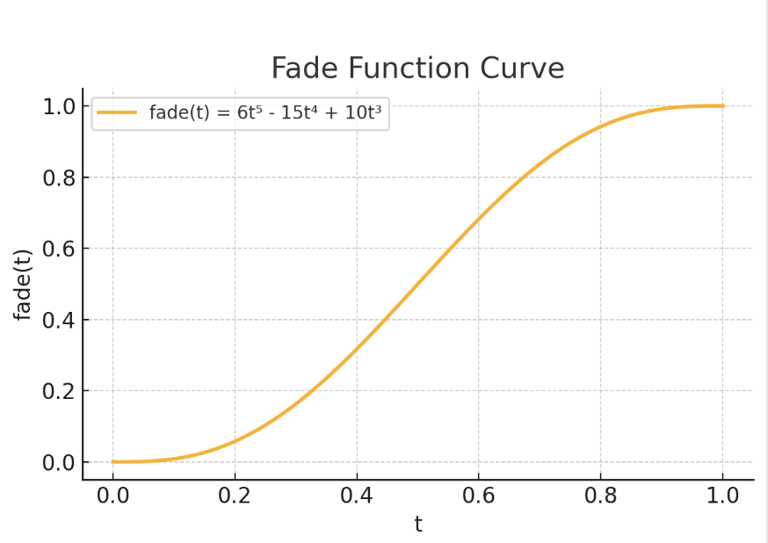
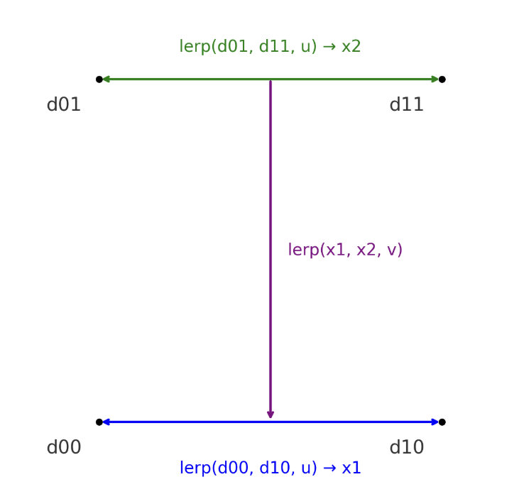
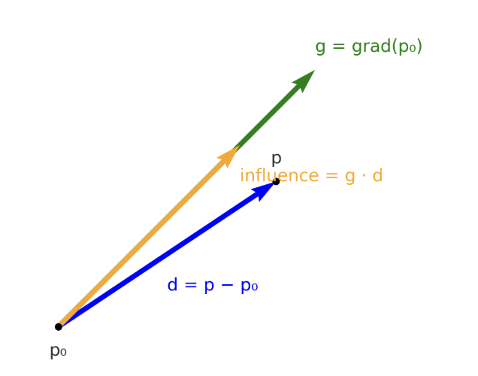
Gradient Field Construction and Interpolation Mechanism
Dot Product: Measuring a Gradient’s Influence
g = grad(p₀)
d = p−p₀
influence = g⋅d
Fade function: Smooth the interpolation weight
fade(t) = 6t⁵ - 15t⁴ + 10t³
Lerp function: Blend values using that weight
lerp(a, b, t) = (1 − t)·a + t·b

Slide 5
Implementation
Generate grids and get local coordinates
Generate pseudo-random lattice gradients
Measure directional influence from lattice gradients
Blend corner influences with smooth interpolation

